Slide 1
Tree Traversals

Slide 2


Binary Tree Traversal Methods
In a traversal of a binary tree, each element of the binary tree is visited exactly once.
During the visit of an element, all action (make a clone, display, evaluate the operator, etc.) with respect to this element is taken.

Slide 3
Binary Tree Traversal Methods
Preorder
Inorder
Postorder
Level order

Slide 4
Preorder Traversal
void preOrder(treePointer ptr)
{
if (ptr != NULL)
{
visit(t);
preOrder(ptr->leftChild);
preOrder(ptr->rightChild);
}
}
Notes:
Ptr points to the root of the subtree being traversed.

Slide 5
Preorder Example (Visit = print)
a
b
c
a
b
c

Slide 6
Preorder Example (Visit = print)
a
b
c
f
d
e
g
j
h
i
a
b
d
g
h
e
i
c
f
j
Notes:
During the traversal, t starts at the root, moves to the left child b of the root, then to the left child d of b. When the traversal of the left subtree of b is complete, t, once again, points to the node b. The t moves into the right subtree of b. When the traversal of this right subtree is complete, t again points to b. Following this, t points to a. We see that t points to every node in the binary tree three times – once when you get to the node from its parent (or in the case of the root, t is initially at the root), once when you return from the left subtree of the node, and once when you return from the node’s right subtree. Of these three times that t points to a node, the node is visited the first time.

Slide 7
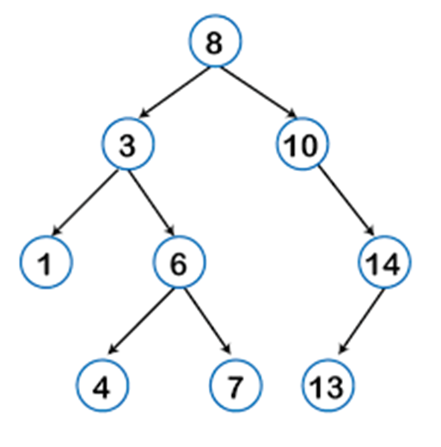
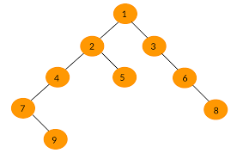

Slide 8
Preorder Of Expression Tree
/
*
+
e
f
+
-
a
b
c
d
/
*
+
a
b
-
c
d
+
e
f
Gives prefix form of expression!

Slide 9
Inorder Traversal
void inOrder(treePointer ptr)
{
if (ptr != NULL)
{
inOrder(ptr->leftChild);
visit(ptr);
inOrder(ptr->rightChild);
}
}

Slide 10
Inorder Example (Visit = print)
a
b
c
b
a
c

Slide 11
Inorder Example (Visit = print)
a
b
c
f
d
e
g
j
h
i
g
d
h
b
e
i
a
f
j
c

Slide 12
Inorder By Projection (Squishing)
a
b
c
f
d
e
g
j
h
i
g
d
h
b
e
i
a
f
j
c

Slide 13
Inorder Of Expression Tree
/
*
+
e
f
+
-
a
b
c
d
a
+
b
*
c
-
d
/
e
+
f
Gives infix form of expression (sans parentheses)!

Slide 14
Postorder Traversal
void postOrder(treePointer ptr)
{
if (ptr != NULL)
{
postOrder(ptr->leftChild);
postOrder(ptr->rightChild);
visit(t);
}
}

Slide 15
Postorder Example (Visit = print)
a
b
c
b
c
a

Slide 16
Postorder Example (Visit = print)
a
b
c
f
d
e
g
j
h
i
g
h
d
i
e
b
j
f
c
a

Slide 17
Postorder Of Expression Tree
/
*
+
e
f
+
-
a
b
c
d
a
b
+
c
d
-
*
e
f
+
/
Gives postfix form of expression!

Slide 18
Traversal Applications
a
b
c
f
d
e
g
j
h
i
Make a clone.
Determine height.
Determine number of nodes.
Notes:
Make a clone using postorder traversal … clone the left subtree, clone the right subtree, clone the root in the visit step.
Determine height using postorder traversal … determine the height of the left subtree, determine the height of the right subtree, in the visit step add 1 to the max of the already determined heights of the left and right subtrees.
Determine number of nodes using preorder, inorder, or postorder traversal … initialize a counter to 0, add 1 to the counter in the visit step.

Slide 19
Level Order
Let ptr be a pointer to the tree root.
while (ptr != NULL)
{
visit node pointed at by ptr and put its children on a FIFO queue;
if FIFO queue is empty, set ptr = NULL;
otherwise, delete a node from the FIFO queue and call it ptr;
}

Slide 20
Level-Order Example (Visit = print)
a
b
c
f
d
e
g
j
h
i
a
b
c
d
e
f
g
h
i
j

Slide 21
Binary Tree Construction
Suppose that the elements in a binary tree are distinct.
Can you construct the binary tree from which a given traversal sequence came?
When a traversal sequence has more than one element, the binary tree is not uniquely defined.
Therefore, the tree from which the sequence was obtained cannot be reconstructed uniquely.

Slide 22
Some Examples
preorder = ab
a
a
b
b
inorder = ab
b
a
a
b
postorder = ab
b
b
a
a
level order = ab
a
a
b
b

Slide 23
Binary Tree Construction
Can you construct the binary tree, given two traversal sequences?
Depends on which two sequences are given.

Slide 24
Preorder And Postorder
preorder = ab
a
a
postorder = ba
b
b
Preorder and postorder do not uniquely define a binary tree.
Nor do preorder and level order (same example).
Nor do postorder and level order (same example).

Slide 25
Inorder And Preorder
inorder = g d h b e i a f j c
preorder = a b d g h e i c f j
Scan the preorder left to right using the inorder to separate left and right subtrees.
a is the root of the tree; gdhbei are in the left subtree; fjc are in the right subtree.
a
gdhbei
fjc

Slide 26
Inorder And Preorder
a
gdhbei
fjc
preorder = a b d g h e i c f j
b is the next root; gdh are in the left subtree; ei are in the right subtree.
a
b
fjc
gdh
ei

Slide 27
Inorder And Preorder
a
b
fjc
gdh
ei
preorder = a b d g h e i c f j
d is the next root; g is in the left subtree; h is in the right subtree.
a
b
fjc
d
ei
g
h

Slide 28
Construct a Binary Tree using the given Tree traversals
Preorder : A B D E H C F I J G
Inorder : D B H E A I F J C G

Slide 29
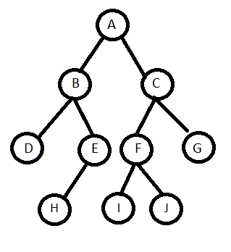

Slide 30
Construct a Binary Tree using the given Tree traversals
Preorder : A B C E F I D G J H K
Inorder : E C I F B J G D H K A

Slide 31
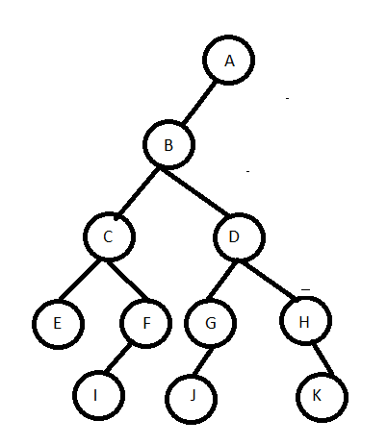

Slide 32
Inorder And Postorder
Scan postorder from right to left using inorder to separate left and right subtrees.
inorder = g d h b e i a f j c
postorder = g h d i e b j f c a
Tree root is a; gdhbei are in left subtree; fjc are in right subtree.

Slide 33
Construct a Binary Tree using the given Tree traversals
Inorder : D B H E A I F J C G
Postorder : D H E B I J F G C A

Slide 35
Construct a Binary Tree using the given Tree traversals
Inorder : E C I F B J G D H K A
Postorder : E I F C J G K H D B A

Slide 37
Inorder And Level Order
Scan level order from left to right using inorder to separate left and right subtrees.
inorder = g d h b e i a f j c
level order = a b c d e f g h i j
Tree root is a; gdhbei are in left subtree; fjc are in right subtree.

Slide 38
Expression Tree Construction
Alg :
Convert the given infix expression into a postfix expression
Read the character from postfix expression
While (ch != “\0”)
{
if ch=“operand” Push into stack
else
{ 1. pop two operands from stack
2. consider the operator as the root node and the operands as its
children
3. push the tree as operand into the stack
}
}

Slide 39
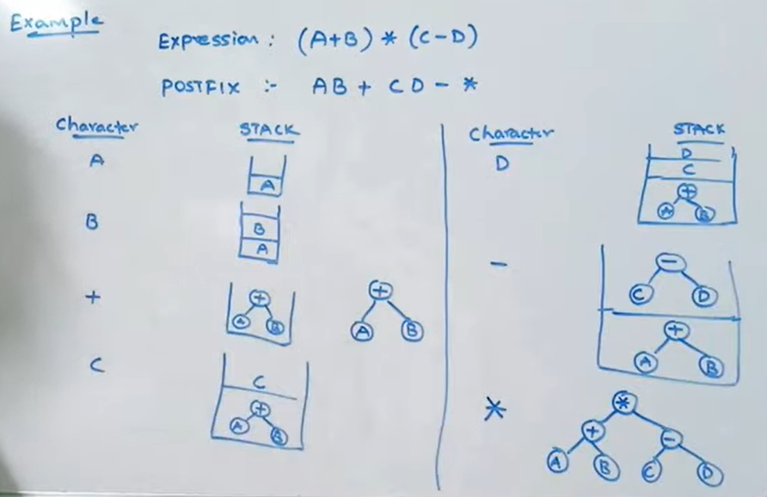

Slide 40
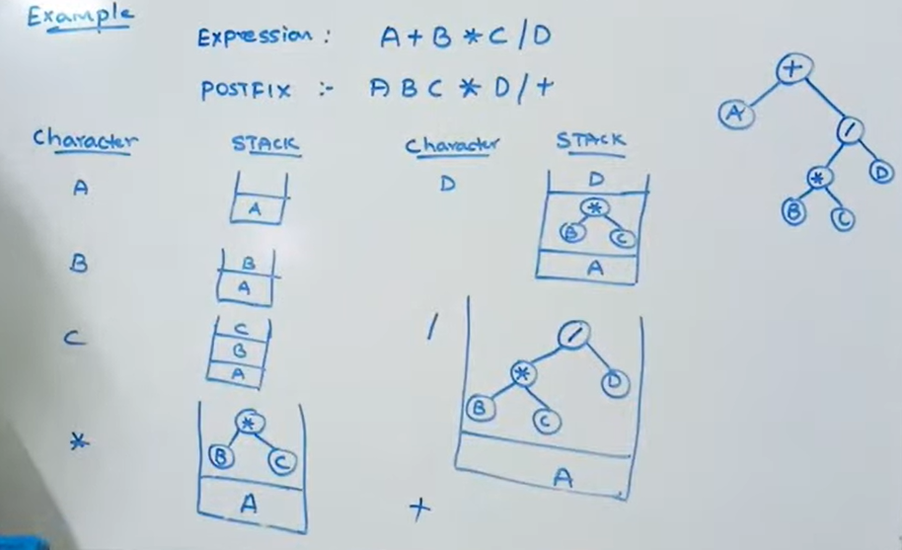

Slide 41
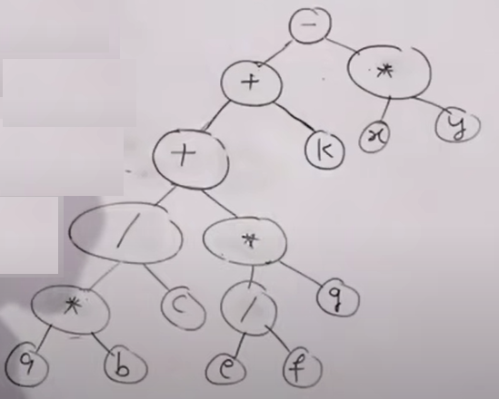
CONSTRUCT EXPRESSION TREES
(another approach)
A * B / C +E / F * G + K –X * Y

Slide 42
Convert General Tree to Binary Tree
All the nodes of the General Tree will be the nodes of Binary Tree
Root of the General Tree be the Root of Binary Tree
Find the branch Parent to Leftmost Child
Connect Siblings of each node Left to Right child
Delete all the link from node to its children

Slide 43
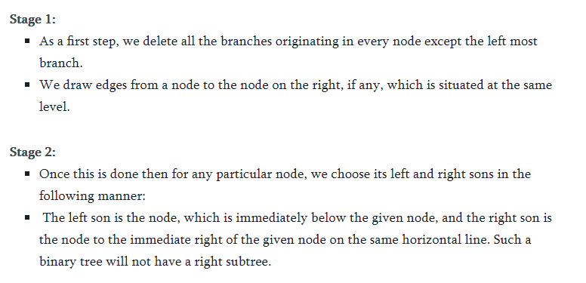


Slide 44
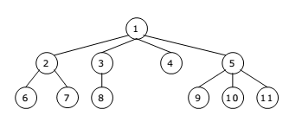
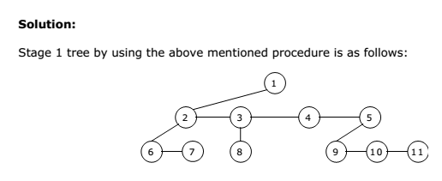

Slide 45
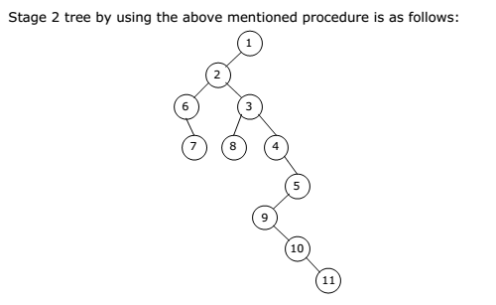

Slide 46

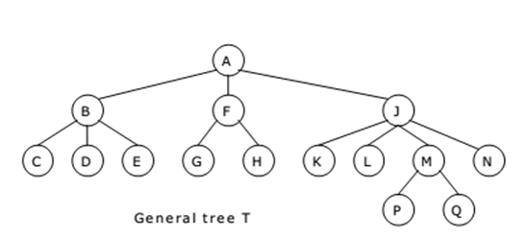

Slide 47
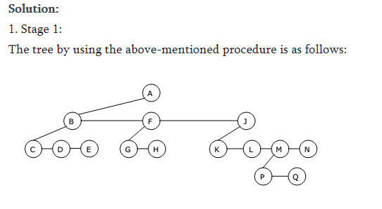

Slide 48
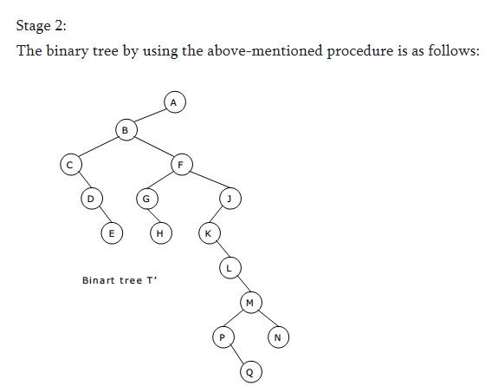

Slide 49
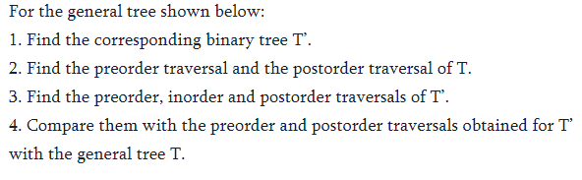
Assignment

Slide 50
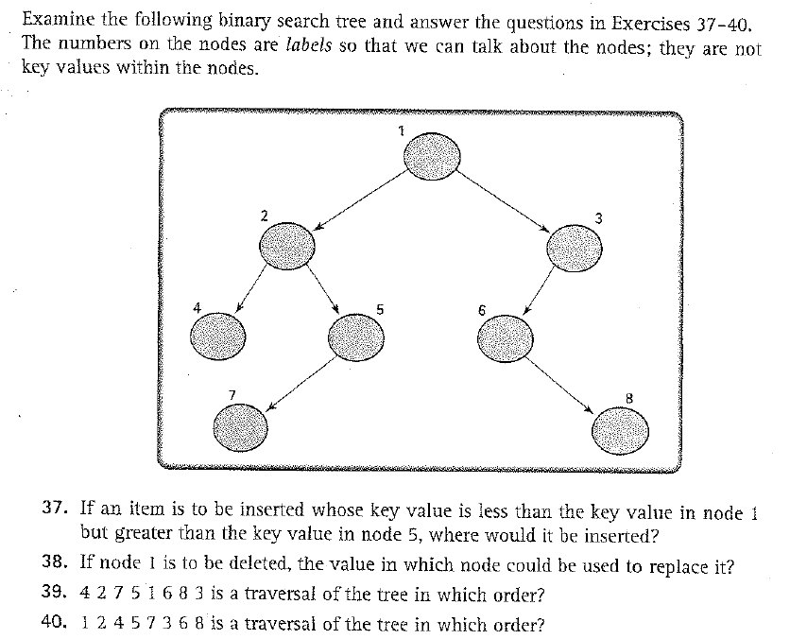
Exercises

Slide 51
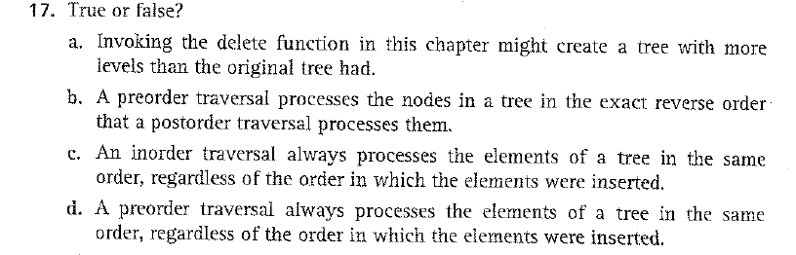
Exercise

Slide 52

Exercise

